Slide 1
IP MULTICAST ROUTING
Radhika Rengaswamy

Slide 2
OUTLINE
What is Multicasting?
IP Multicast Addressing
IGMP
Multicast Forwarding Algorithms
  Simple, Source-Based Tree, Shared-Tree
Multicast Routing Protocols
  Dense-mode (DVMRP, MOSPF, PIM - DM)
  Sparse-mode (PIM - SM, CBT)

Slide 3
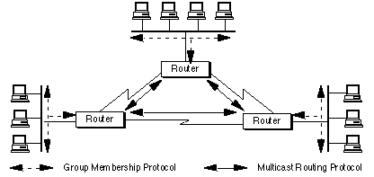
Multicast Forwarding

Slide 4
Time To Live (TTL)
Scope-limiting parameter for IP Multicast datagrams
Controls the number of hops that a IP Multicast packet is allowed to propagate
TTL = 1: local network multicast
TTL > 1: Multicast router(s) attached to the local network forward IP Multicast datagrams

Slide 5
Internet Group Management Protocol (IGMP)
Used by mrouters to learn about Multicast Group Memberships on their directly attached subnets
  the existence of at least one member/group
Implemented over IP
Designated Router
  Each network has one Querier
  All router begin as Queriers
  Mrouter with the lowest IP address chosen

Slide 6
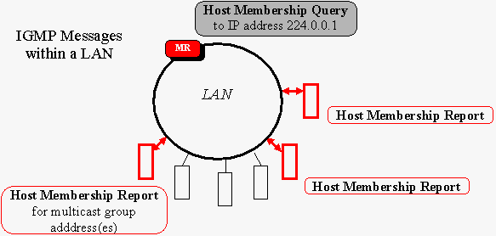
IGMP Messages

Slide 7
Multicast Routing
Unicast vs. Multicast routing
  Multicast address identifies a particular transmission session
  Network routers need to translate multicast addresses into host addresses
Multicast Forwarding Algorithms
  Simple
    primitive techniques that waste a lot of BW and router resources.
    do not scale well for larger groups.
  Source based trees
  Shared trees

Slide 8
Flooding
When a router receives a multicast packet for a group, it determines if it is the first time it has seen the packet
Then, it forwards it on all interfaces except the incoming interface.
Routers only need to store recently seen packets

Slide 9
Spanning tree
Just enough connectivity so that only one path between every pair of routers
A router copies an incoming packet only on the interfaces part of the spanning tree
Packets replicated only when the tree branches
Source/Destination based routing
Dynamically updated
Diasadv: Centralize traffic, sub-optimal tree between source and destination

Slide 10
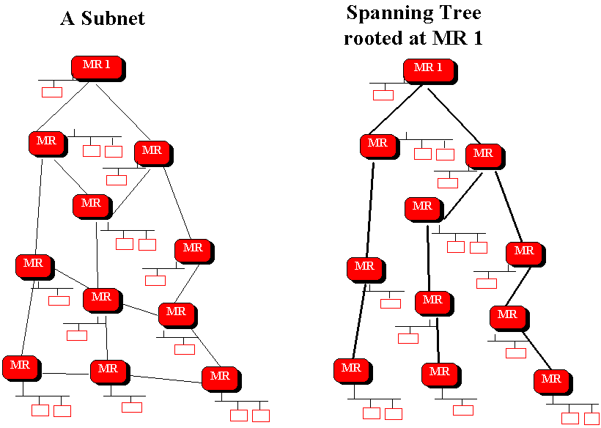

Slide 11
Reverse Path Broadcasting (RPB)
Different spanning tree constructed for each active (source, group) pair
Parent Link: the link the router considers to be the shortest path back to the source
Limitation: Does not consider group memberships when constructing trees
Source
Shortest path
to source
“parent” link
I2
child
I1
Router
I3
child

Slide 12
Example of Reverse Path Broadcasting
S
A
Router
1
2
Leaf
B
C
3
Shortest-path
5
6
7
4
Branch
E
D
F
8
9

Slide 13
Truncated Reverse Path Broadcasting (TRPB)
Use IGMP
Forward only to Leaf networks with members
Lim: Does not consider group memberships
Source
(Source, G1)
“parent” link
G1
I2
G2
G3
hub
child
I1
Router
I3
child
switch
G1
I4
G3
Truncate
Forward
child

Slide 14
Reverse Path Multicasting (RPM)
Creates a delivery tree that spans only:
  Subnetworks with group members, and
  Routers and subnetworks along the shortest path to subnetworks with group members
  Allows the source-rooted tree to be pruned
The first packet is forwarded using TRPB
Downstream routers send Prunes if they have no members
Periodically refresh pruned tree using TRPB
Lim: Scalability

Slide 15
Reverse Path Multicasting
Source
(Source,G)
G
Router
Leaf w/o group mem.
G
Leaf with group mem.
Active branch
G
Pruned branch
G
G
Pruned message

Slide 16
Core-Based Trees (CBT)
Constructs a single delivery tree that is shared by all members of a group
  a spanning tree per group
Core routers
Join messages towards the core
Non-members unicast the data to the core
Good scalability and conservation of BW
Lim: Concentration of traffic and sub-optimal trees

Slide 17
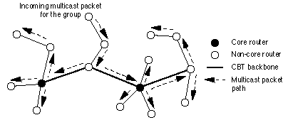
Multi-Core CBT Delivery Tree

Slide 18
Dense - Mode Multicast Routing Protocols
DVMRP, MOSPF, PIM-DM
Assumptions
  group members are densely distributed throughout the network
  BW is plentiful
Rely on periodic flooding of the network with multicast traffic to set up and maintain the spanning tree
Data - driven approach to construct the tree

Slide 19
Distance Vector Multicast Routing Protocol (DVMRP)
Distributed protocol that generates IP Multicast delivery tree per source-group
Shortest path from Source to hosts
  based on Number of hops metric
Derived from Routing Information Protocol
  RIP forwards the unicast packets based on the the next-hop towards a destination
  DVMRP constructs delivery trees based on shortest previous-hop back to the source
Supports hierarchical routing

Slide 20
Algorithm
Per-source broadcast trees built based on routing exchanges ( using DVRP)
Reverse Path Multicasting
  Initially, assume that every host on the network is part of the Multicast group (TRPB)
  Per Source-Group Multicast delivery tree
  Reverse Path Forwarding check
  Poison Reverse
    Determine downstream interfaces to forward the packet on
  Prune and Graft messages

Slide 21
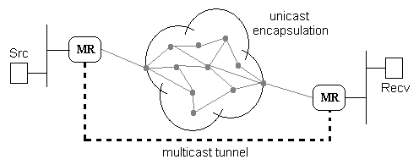
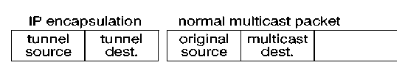
Tunnel Encapsulation
Encapsulated in IP packets

Slide 22
Neighbor Discovery
Neighbor Probe messages with TTL = 1
Addressed to “ALL_DVMRP_ROUTERS”
Contains a list of Neighbor DVMRP routers for which a Probe has been received on that interface
  Establish “Two-Way adjacency”
  Know capabilities of routers (Version no)
  Keep-alive function
Sent every 10 secs
Neighbor time-out: 35secs

Slide 23
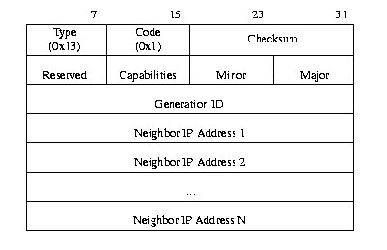
DVMRP Probe Message Format

Slide 24
Length depends on # of neighbors
Generation ID
  Non-decreasing number used to detect restart of the router
  When a change in Gen ID is detected, a copy of the routing table is unicast to the router
  Any prune received from the router discarded
    If the prune was propagated UP, a Graft sent
Only when “Two-way adjacency” established, the router can send Poison Route reports

Slide 25
Source Location
When a multicast datagram is received at the router
  Look up the source network in the routing table
  RPF check
  Forwarding cache entry created
Provide consistent view of shortest path to the source
  Propagate routing table to all routers

Slide 26
Route Exchange Reports
Network number, Mask and Metric of interfaces directly connected to it
Each interface has a metric configured
  Physical interfaces use a metric of 1
  Tunnel interfaces metric varies with distance and BW in the path
Also relay routes received
  Adjusted Metric relayed

Slide 27
Poison Reverse
  To determine if any downstream interfaces depend on them for forwarding data
  If the interface is the best previous hop back to the source, the downstream router echoes the route on the upstream interface with an adjusted metric of “infinity + original metric”
  Upstream router adds the downstream interface to the list of dependent interfaces
  To determine Pruning of the Source-Group tree

Slide 28
Designated Forwarder
  When two or more Mrouters connected to a multi-access network
  Both routers may forward packets on the LAN
  Elect one router per source Router with lowest metric back to the source
  Equal metrics, router with lowest IP address
Route report interval of 60 secs

Slide 29
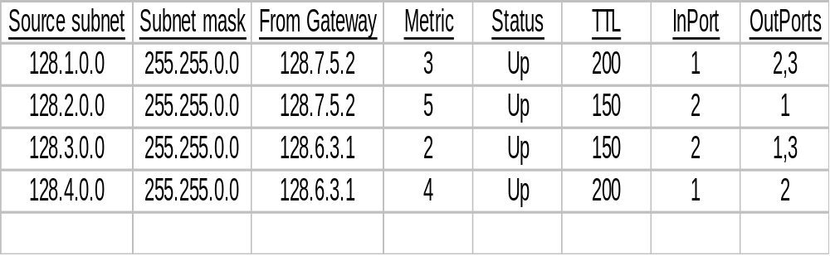
Routing Table
Does not consider group memberships
Source Subnet
  The subnetwork containing the source host

Slide 30
Building Multicast Trees
Determine upstream interface : RPF
Forward on downstream interfaces
  Initially, all downstream interfaces determined by Poison Reverse are part of tree
  If downstream interface is a Leaf network
    Consult IGMP Local database
  Non-Leaf Networks
    Delete interface if a Prune is received

Slide 31
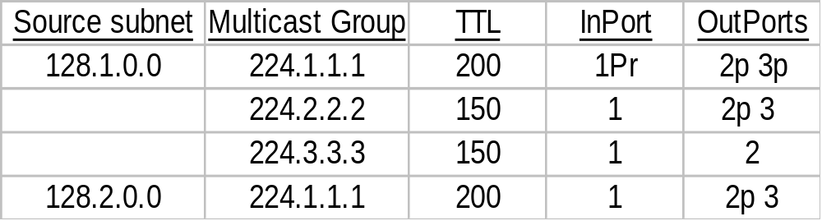
Forwarding Cache Entries
Separate entries for each (Source network, Destination group) pair
Created on demand based on Routing table, Group memberships and Prunes

Slide 32
Pruning Multicast Trees
If a router has no dependent downstream interfaces, a Prune sent up to delete that interface from list of dependent interfaces
  Leaf networks without any host members
  Non-leaf networks, all downstream interfaces send a Prune
Propagates up
Limit the life of a Prune
  Periodically resume TRPB
May include Network mask to specify specific source data to be pruned

Slide 33
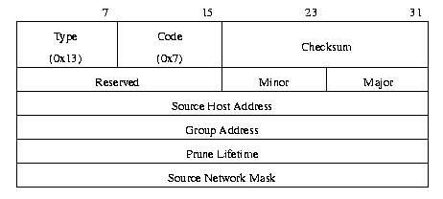
Prune message Packet Format

Slide 34
Grafting
To support dynamic host memberships
To cancel previously pruned interfaces
  When a new host joins the group
  Or a graft message received from downstream
Separate messages sent for each source network pruned
Acknowledge each Graft with a “Graft ACK” hop by hop

Slide 35
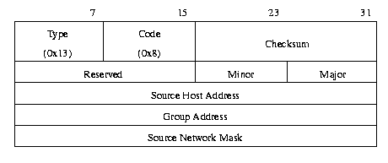
Graft / Graft ACK Packet Format

Slide 36
Multicast Open Shortest Path First (MOSPF)
Multicast extensions to OSPF v2.
  Route packets along least-cost paths
  Cost : Link state metric
  Metric : Can be configured to distance, load..
Source/Destination routing
Each router maintains the up-to-date image of the topology of the entire network
For use within a single routing domain
Supports hierarchical routing, load balancing and import external route info.

Slide 37
MOSPF Algorithm
Hello Protocol
  Form adjacency with neighbor
Each MOSPF router maintains an identical Link State Database describing the AS topology using LSAs
  Each router floods its local state through the AS
Source-rooted Shortest path tree for each [source network, destination group] pair
External routing data from BGP used
  Flooded throughout the AS

Slide 38
Type Origin Scope Description
Router All routers Inside an area Collected state of routers’ interfaces to an area
Network All networks Inside an area List of routers (Designated connected to the router) network
Summary By ABRs Inside associated Describes routes to ABRs area destinations outside the area
AS-External By ASBRs Flooded thru AS Describes routes to destinations in other AS
Group DR of Inside an area Lists networks with
Membership networks Specific to a hosts connected to group that group

Slide 39
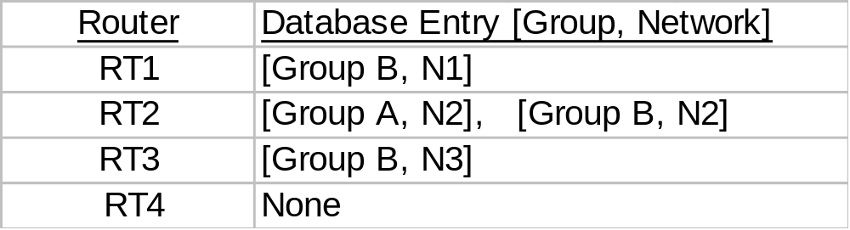
Local Group Database
Use IGMP to monitor group memberships
  Designated router in a network
List of directly attached group members
DR generates the Group Membership LSA
  For each multicast group in the database
  Flooded through the area

Slide 40
Link State Database
Describes a directed graph
  Vertices: Routers and Networks
Cost associated with each outgoing interface of the router
Derived from LSA of routers and networks and Group memberships
Source-rooted SPT calculated at each router
  Based on LS database (Router, Network LSAs)
  Provides the best route to any destination in AS
  Pruned SPT - Group membership LSAs

Slide 41
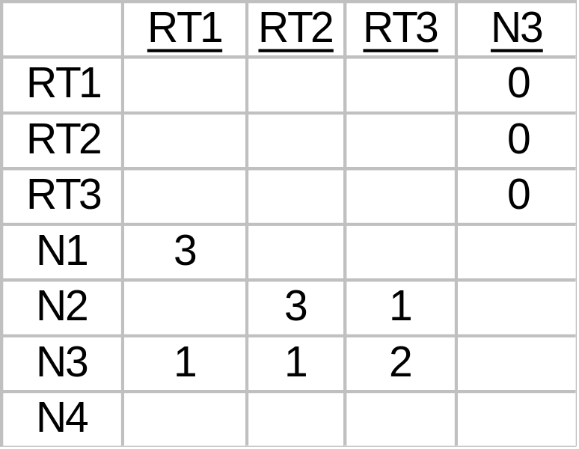
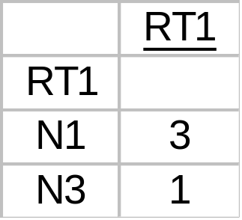
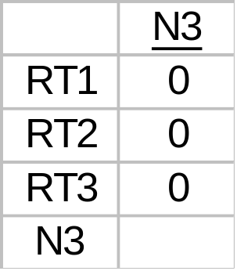
N1
3
H2
RT1
1
Mb
Mb
Mb
N3
3
1
N2
RT2
1
RT3
H3
2
H1
Ma
Link State Database
N4
Group A: RT2
Group B: R1, RT2, N3
R1’s router-LSA
N3’s network LSA

Slide 42
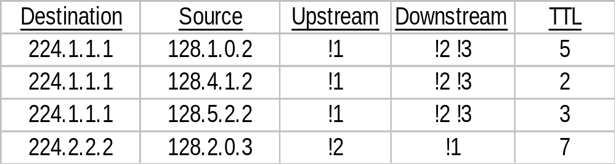
Forwarding Multicast Datagrams
Each router determines its position in the pruned SPT
  Upstream and Downstream interfaces
Create a forwarding cache entry the first time and use it for further routing
  Entry changes only when the topology or Group membership changes

Slide 43
Splitting of the AS
Number of areas connected by the Backbone
Each area has its own Link state database
  Topology of one area invisible to the other
Backbone
  Responsible for distributing data between areas
Routing
  Intra-area, Inter-area, Inter-AS

Slide 44
Area Configuration
LS Database for an area contains
  All the paths within the area
  Area border router(ABR) advertise into the area
    costs to all external destinations (Inter-area SPT)
    Location of AS boundary routers
    AS-External-LSAs from ASBRs flooded (Inter-AS SPT)
Backbone Database
  ABRs summarize the topology of the area
    Heard by all other ABRs
  ASBRs externally derived information
  SPT: SP between all ABRs and ASBRs

Slide 45
Inter-Area Routing
Subset of ABRs - “Wild card Inter-area Multicast Forwarders / Receivers”
  Forward Group membership and Topology info into the backbone
  Receive all multicast traffic generated in the area regardless of the group
Backbone forwards the data to appropriate ABRs
BACKBONE
AREA 1
AREA 2
AREA 3

Slide 46
SPT Calculation
Using wild-card receivers and Summary Link LSAs
CASE I: Source n/w and calculating router in same area
  Only branches without members and Non-wild card rx are pruned
Source containing
group members
S
Area 1
Intra-area MOSPF
router
Wild-card Multicast
Receiver
To other areas

Slide 47
CASE II: Source n/w and calculating router in different areas
  Estimate the source n/w to ABR distance using Summary Link LSA info
S
S
Source subnetwork
Inter-Area
Multicast Forwarder
Summary Links LSA
Subnet with
group members
Area 1
Intra-area
MOSPF router

Slide 48
Inter - AS Routing
Some ASBRs - “Inter-AS Multicast Forwarders” or “Wild-card Multicast Receivers”
Each ASBR executes an Inter-AS routing protocol like DVMRP
Case I & II: Same as Inter-area Routing
  Difference: ASBRs should not be pruned too

Slide 49
Case I : Source subnetwork and calculating router are in the same AS
Area 1
S
Source subnetwork
S
Inter-Area
Multicast Forwarder
Subnet with
group members
Intra-area
MOSPF router
Inter-AS
Multicast Forwarder
To other
Autonomous
systems
To other areas

Slide 50
Case III: Source n/w and calculating router in different AS
  Use AS-External Links describing source subnetwork
S
S
Source subnetwork
Inter-AS
Multicast Forwarder
AS External Links
Subnet with
group members
Area 1
Intra-area
MOSPF router
Inter-Area
Multicast Forwarder
To other areas

Slide 51
Protocol Independent Multicast (PIM)
Under development by IDMR
To develop a scalable protocol independent of any particular unicast protocol
  ANY unicast protocol to provide routing table
A router can switch between DM and SM depending on the group

Slide 52
PIM Dense Mode
Deployed in resource rich environments
RPM Algorithm
  Similar to DVMRP
Algorithm
  A datagram is forwarded if the arriving interface is the shortest path back to the source
  Datagram forwarded on all outgoing interfaces initially
  Create forwarding cache entry
  Prune and graft messages used to prune the tree

Slide 53
Leaf Network Detection
  Absence of PIM Hello messages
  No host membership reports
Pruning on a Multi-access LAN
  A prune is sent upstream when the outgoing interface list is empty
  Upstream router schedules the interface for deletion (Delay 3 sec)
  Any other routers on the LAN that depend on the upstream router send a PIM-Join
    Deletion request of interface cancelled
    Randomly delay Join message to reduce traffic
  Prunes are flushed periodically

Slide 54
Graft and Graft ACKs
Designated Router in Multi-access LANs
  Highest IP address router as seen in “Hello”
Assert Messages
  When duplicate packets arrive on a multi-access LAN
  Send Assert with metric for that source
  Choose router with lower metric
  Equal metrics, higher IP address prevails
  Modify upstream and downstream neighbors

Slide 55
Sparse - Mode
PIM-SM, CBT
Assumptions
  group members are sparsely distributed throughout the network
  BW not widely available
Receiver initiated construction of the spanning tree
    Limit multicast traffic and hence improve scalability
Define a Rendezvous Point (RP) and build the multicast tree around it

Slide 56
Algorithm
  Sender sends data to the RP
  Receivers JOIN the RP tree
Difference from DM
  Receiver initiated vs Data Driven
  SM routers maintain state info ( Primary RP)
Advantages
  Conserve network resources
  Decreased amount of info in routers
Disadvantages
  Concentration of traffic around RP
  Sub-optimal trees increase Latency

Slide 57
PIM Sparse Mode
Independent of particular unicast routing protocol
Algorithm
  Senders send data to the RP
  Receivers JOIN the tree
  Unwanted branches pruned
  Receivers can switch trees
S1
S2
Rendezvous
Point
Rendezvous
Point
R
R
R
R
R
R
R

Slide 58
Designated Router
  Multiple routers on a LAN : Highest IP address
  Responsibilities
    IGMP Queries
    JOIN/Prune messages towards RP
    Maintain status of active RP
Route Entry
  Source address, Group Address
  Incoming interface (towards RP)
  Outgoing interfaces (towards receivers)
  WC-bit: Any source would match (*,G)
  RPT-bit: Join sent up the shared RP tree

Slide 59
Receivers : when a new host report received
  Look up primary RP for that group
  Unicast JOIN message to the RP
    Payload: Address G, Join = RP, WC_bit, RPT_bit, PRUNE = NULL
  Create forwarding route entry for (*,G) pair
    Delete cache entry when no more members
  Intermediate routers transmit JOIN to RP
    Create forwarding route
    entry for (*,G)
Source (S)
Designated
Router
Rendezvous Point
(RP)
for group G
Host
(receiver)
Join
Join

Slide 60
Hosts sending to Group
  Its DR looks up the active RP for that group
  Unicast data, encapsulated in a PIM-SM-Register to the RP
  Active RP sends a PIM-Join to the source DR
  Intermediate routers maintain state info (*,G)
  When source gets a Join, it sends further packets without encapsulation
  RP resends all data on the shared tree
Source (S)
PIM Router
Rendezvous Point
DR
PIM-Register
PIM-Join
Resend to Group members
Host
(receiver)
Host
(receiver)
RP

Slide 61
  If data rate warrants an SPT, an (S,G) state created
    RP sends periodic Join/Prune to the source
    Intermediate routers maintain (S,G) state info
  Sources stop encapsulating data when they receive Register-Stop messages
    RP has no downstream members for that group or source
    RP already receives native data from (S,G) tree
Switching from RP-Shared tree to SPT
  Depending on the data rate of a particular source, a switch over may be initiated
    Only by RP or routers with members
  Activate (S,G) route entry

Slide 62
  JOIN/PRUNE message from the rx towards the source
    Payload: Address G, Join = S, Prune = NULL
  Prune towards the RP for that (S,G)
Steady state of distribution tree
  Each router periodically sends JOIN/PRUNE for each active route entry
    To the neighbor indicated in the route entry
    Helps capture changes in topology/state/membership
Source (S)
RP Tree
SP Tree
Host
(receiver)
DR
RP

Slide 63
RP Information
  Bootstrap messages are used to distribute RP information within the domain
  Domains’ Bootstrap Router (BSR) elected from set of candidates
  A set of RP candidates periodically advertise to the BSR the groups associated with them
  C-RP-Advertisements: Address of C-RP, Group address and mask
  C-RP-Advs distributed in BS messages
  The Advs are used by DRs
    use a Hash function to map a group address to one C-RP whose ad includes the group

Slide 64
Inter-operation with DM Protocols
All PIM-SM generated packets distributed into the DVMRP domain by PMBRs
  PMBRs send JOIN/PRUNE to each RP
All PIM-SM routers support (*,*,RP)
  Aggregate all groups associated with an RP
Delivery of external packets
  PMBRs encapsulate data in Registers and unicast to corresponding RP
  PMBR route entry created
  Register-Stop sent to PMBR

Slide 65
Data Forwarding
Longest match route entry used
  (S,G)
  (*,G)
  (*,*,RP)
  Else discarded
Match Incoming interface
Dominant Router
  Elected using Assert messages (Same as DM)

Slide 66
Core Based Trees (CBT)
Construct a single tree shared by a Group
Similar to PIM-SM
  Protocol independent
  Bootstrap Core Discovery
Differences
  Receiver cannot switch from RP-tree to SPT
  CBT state bi-directional
    data flows in either direction along the branch
    data from a source directly connected to an existing tree branch need not be encapsulated
Core router equivalent to RP

Slide 67
Protocol
  Host sends IGMP report to Join a group
  JOIN-Request sent towards the core router
  JOIN_Request is explicitly acked using JOIN-Ack by core or on-tree router
  Intermediate routers set up Transient state
    <Group, Incoming interface, Outgoing interface>
  Transient state converted to Active state by JOIN-Ack
    Bi-directional state
  On-tree routers lookup forwarding cache to forward data

Slide 68
Data from non-members
  Encapsulated as IP-over-IP and unicast to Core
Echo-Request
  Each on-tree router is responsible for maintaining its Upstream link
  Sent to the Upstream router
  Carries a list of groups for which the upstream router is the parent
Echo-Reply
  From the parent with the list of groups attached to the child interface

Slide 69
Flush-Tree
  If link to a Parent fails, Flush-tree transmitted on all its child interfaces
  Causes tearing down of all downstream branches for that group
  Each downstream router responsible for re-attaching itself to the tree
Hello Protocol
  Elect Designated router and Border routers
Quit Notification
  Prune message sent upstream if no child interface list
Bootstrap and C-Core-Adv

Slide 70
References
MOSPF: RFCs 1584, 1585
PIM-SM: RFC 2362
CBT: RFCs 2201 and 2189
DVMRP: RFC 1075 and Internet draft
PIM-DM: Internet Draft
IGMPv2: RFC 2236
Cisco, 3com web sites

